Slide 1

ACHARYA INSTITUTE OF TECHNOLOGY BANGLORE-107 Department of Computer Science & Engineering MONGODB Installation and CRUD operations
By – Aditi DAS
AIT21BECS073
1AY21CS014

Slide 2
MONGO DB
Overview Installing Mongo DB and Shell CRUD operations

Slide 3
MONGO DB
Overview:
MongoDB is a non-relational, document-oriented database that uses a flexible data model.
Database type
MongoDB is a NoSQL (Not only SQL) database, which is an alternative to traditional relational databases.
Data model
MongoDB uses a document-oriented data model, which means that data is stored in flexible documents that are similar to JSON. Documents can have their own unique structure, with nested fields and arrays. Document databases store documents in the value part of the key-value store.

Slide 4
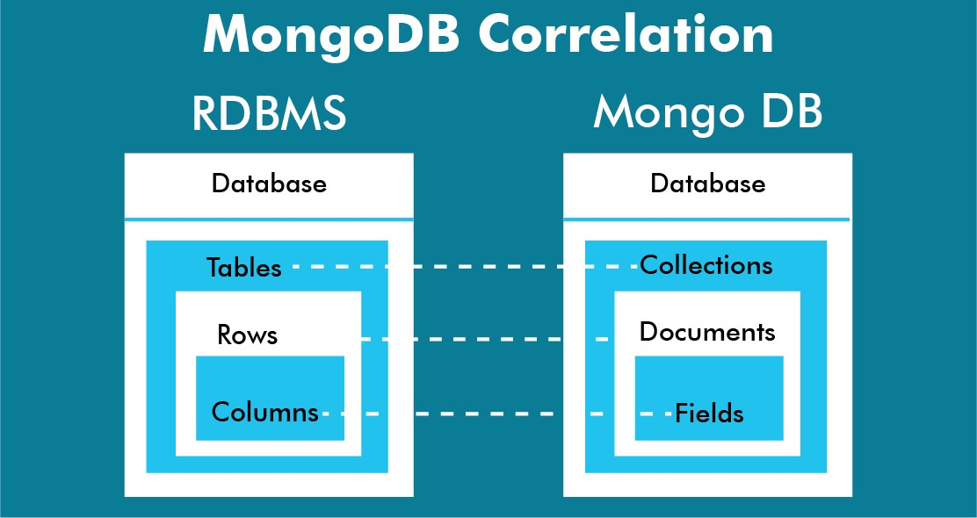
MONGO DB
Data storage
MongoDB stores records as documents in compressed BSON files. Documents can be retrieved directly in JSON format.
Data organization
MongoDB uses collections and documents instead of tables and rows. Collections are similar to SQL tables and contain sets of documents.

Slide 5

How to Install MongoDB on Windows
Requirements to Install MongoDB on Windows
MongoDB 4.4 and later only support 64-bit versions of Windows.
MongoDB 7.0 Community Edition supports the following 64-bit versions of Windows on x86_64 architecture:
Windows Server 2022
Windows Server 2019
Windows 11

Slide 6
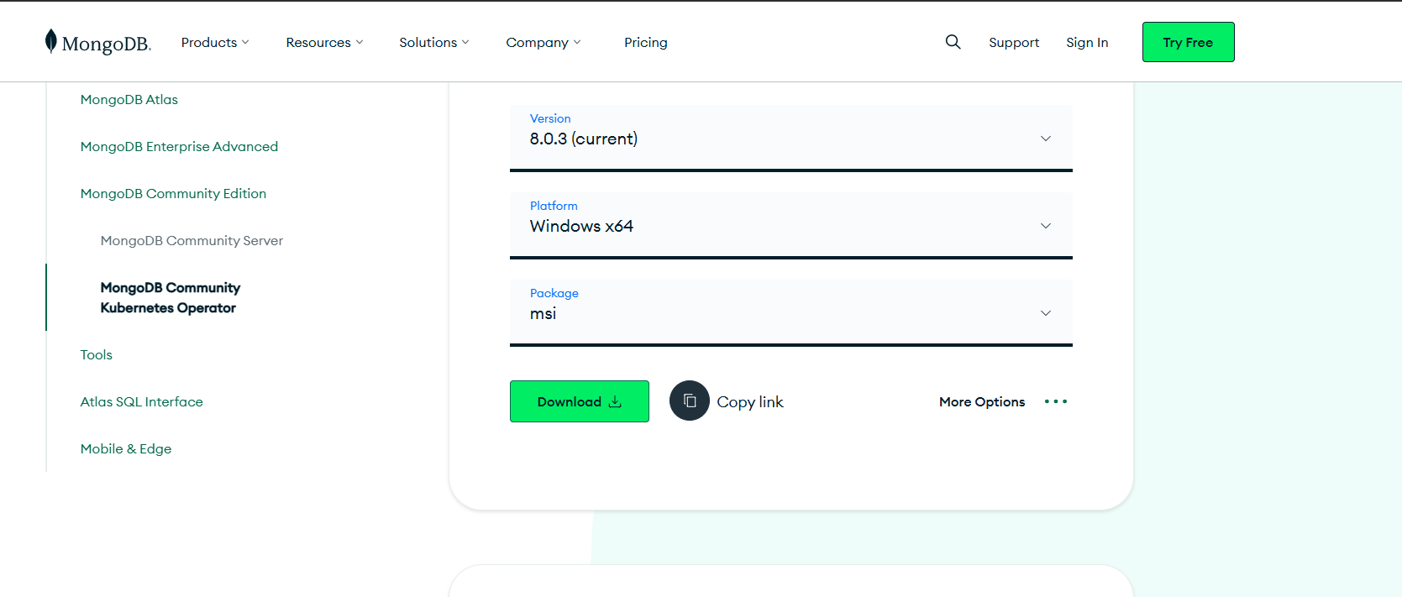
Steps to Install MongoDB on Windows using MSI
Step 1: Go to the MongoDB Download Center under Products to download the MongoDB Community Server.

Slide 7
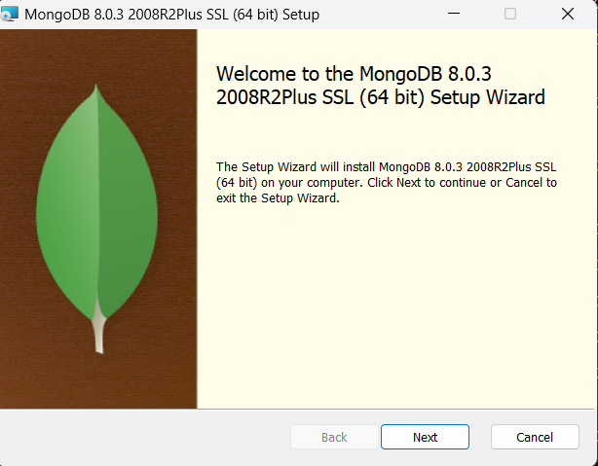
Steps to Install MongoDB on Windows using MSI
Step 2: When the download is complete open the msi file and click the next button in the startup screen:

Slide 8
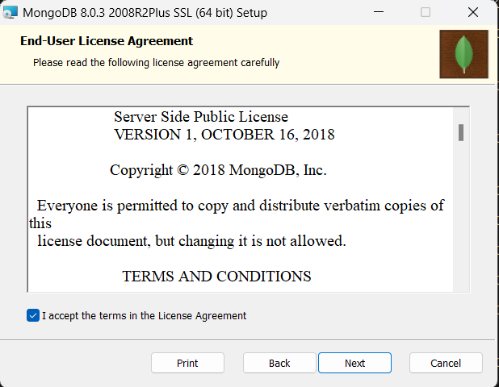
Steps to Install MongoDB on Windows
Step 3: Now accept the End-User License Agreement and click the next button :

Slide 9
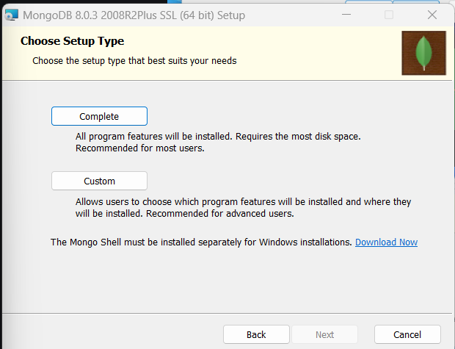
Steps to Install MongoDB on Windows
Step 4: Now select the complete option to install all the program features. Here, if you can want to install only selected program features and want to select the location of the installation, then use the Custom option:
.

Slide 10
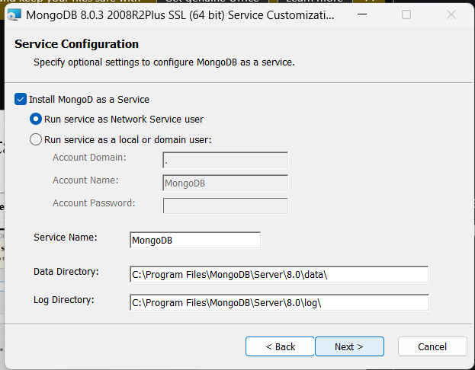
Steps to Install MongoDB on Windows
Step 5: Select “Run service as Network Service user” and copy the path of the data directory. Click Next: .

Slide 11
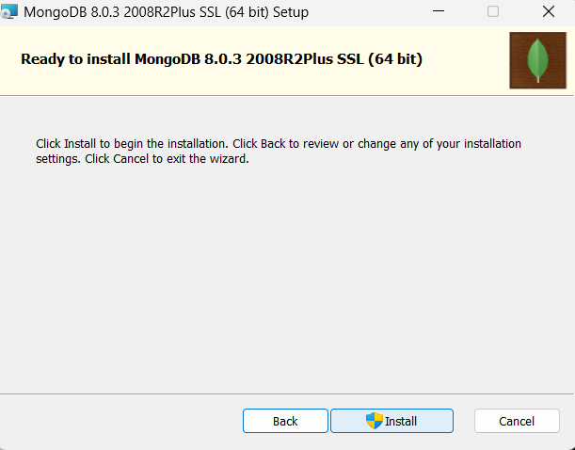
Steps to Install MongoDB on Windows using MSI
Step 6: Click the Install button to start the MongoDB installation process: .

Slide 12
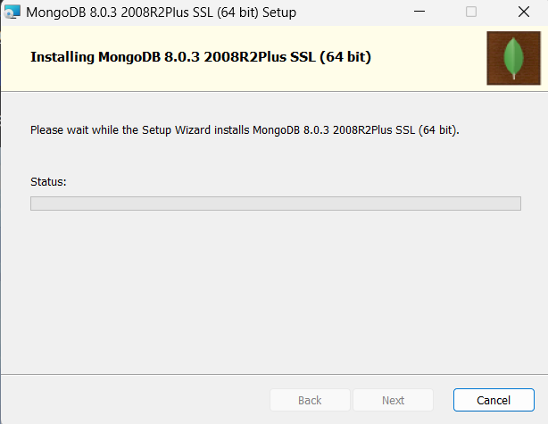
Steps to Install MongoDB on Windows
Step 7: After clicking on the install button installation of MongoDB begins: .

Slide 13
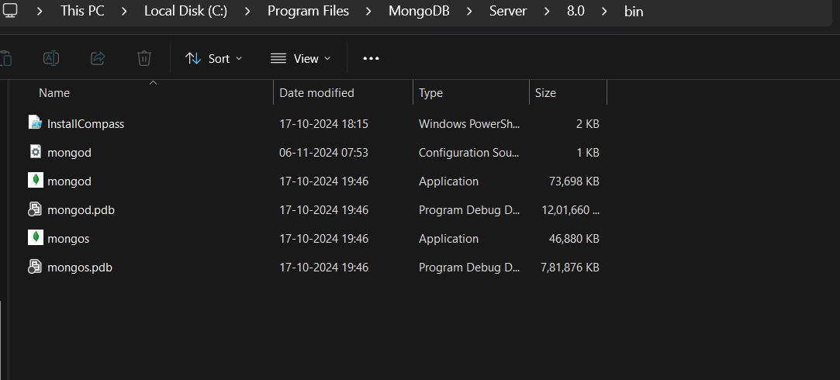
Steps to Install MongoDB on Windows
Step 8: Now click the Finish button to complete the MongoDB installation process
Step 9: Now we go to the location where MongoDB installed in step 5 in your system and copy the bin path:

Slide 14
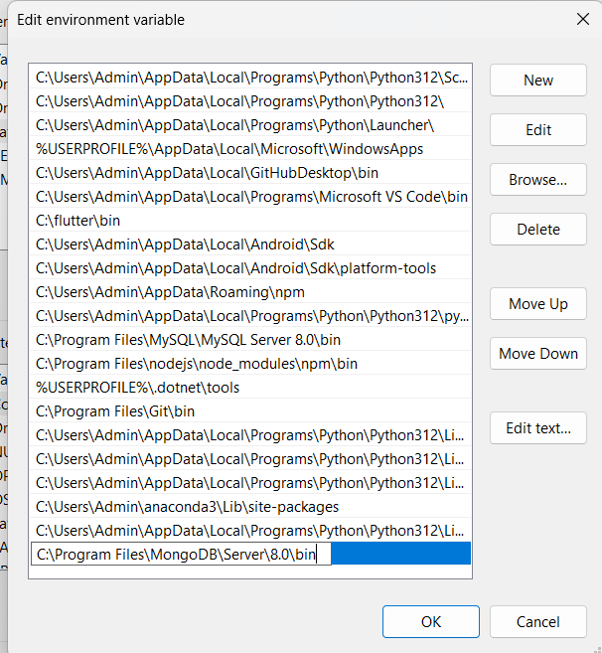
Steps to Install MongoDB on Windows
Step 10: Now, to create an environment variable open system properties >> Environment Variable >> System variable >> path >> Edit Environment variable and paste the copied link to your environment system and click Ok:

Slide 15
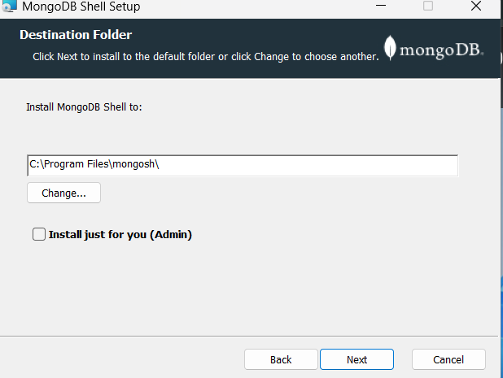
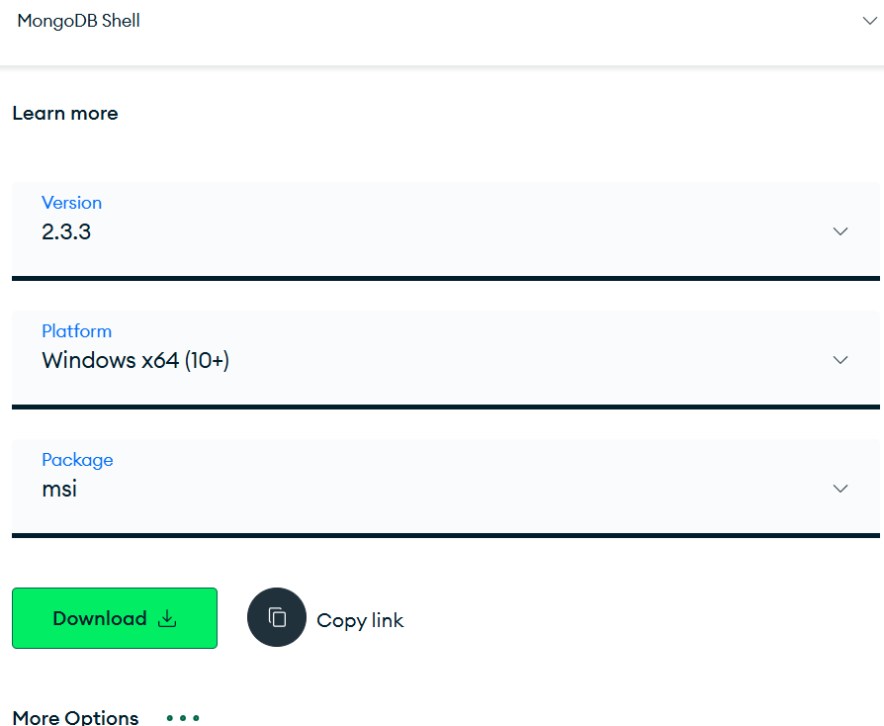
Download MongoDB Shell
Step 11: Through the browser go to MongoDB Shell Download and download the msi package and install it for all the users . Click on next and finish the installation.

Slide 16
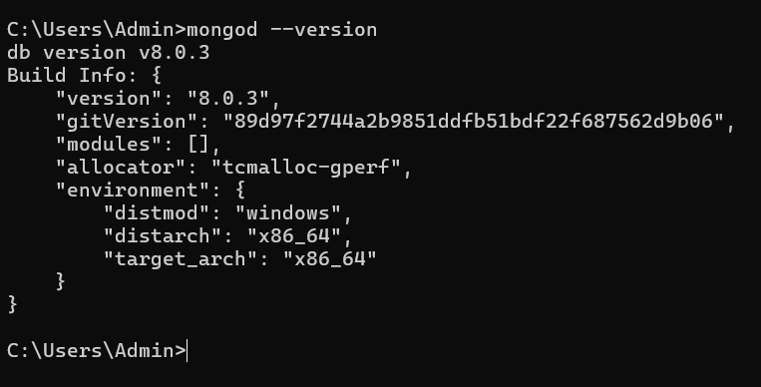
Verify the installation
Step 12: Go to cmd and enter mongod --version

Slide 17
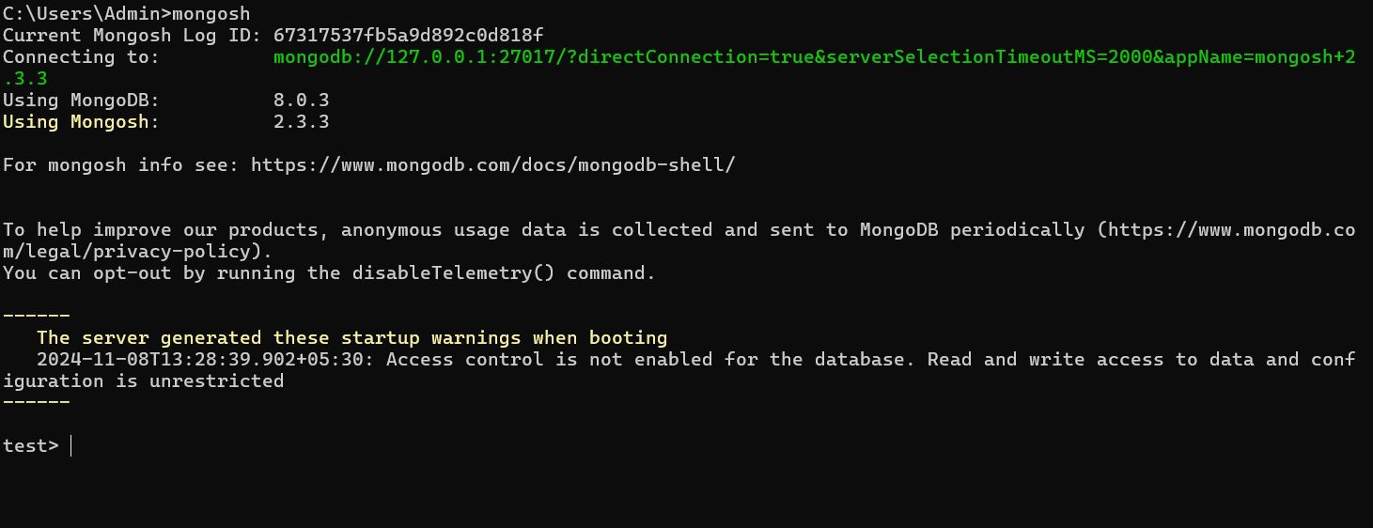
Mongo shell
Step 13: Go to another cmd and enter mongosh

Slide 18
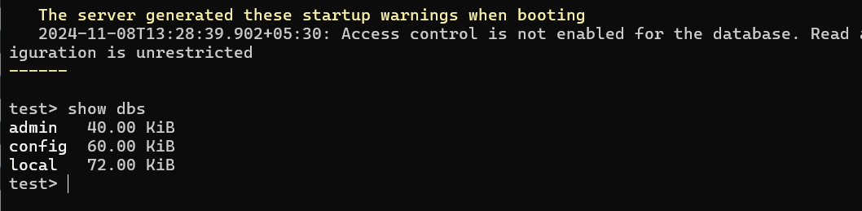
Mongo shell
Step 14: type show dbs to show the databases which shows us the current databases that are present

Slide 19
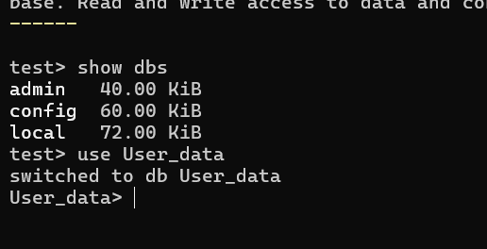
Creating new Database
Step 15: type use <database_name> and it switches to the new database

Slide 20
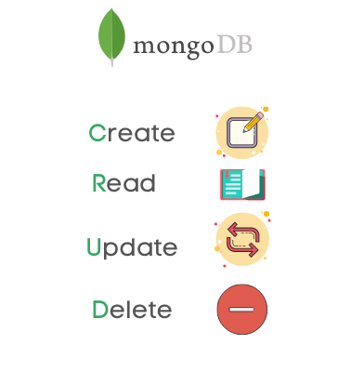
CRUD operation
CRUD operations describe the conventions of a user interface that let users view, search, and modify parts of the database.
MongoDB provides an elegant way of performing CRUD operations with the programming language of your choice through its drivers.

Slide 21
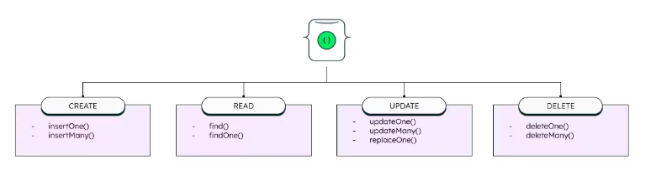
CRUD OPERATIONS
When it comes to the individual CRUD operations:
The create operation is used to insert new documents in the MongoDB database.
The read operation is used to query a document in the database.
The update operation is used to modify existing documents in the database.
The delete operation is used to remove documents from the database.

Slide 22
CREATION OPERATION
Create operations in MongoDB target a single collection, not multiple collections. Insert operations in MongoDB are atomic on a single document level.
MongoDB provides two different create operations that you can use to insert documents into a collection:
db.collection.insertOne()
db.collection.insertMany()

Slide 23
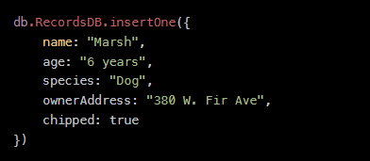
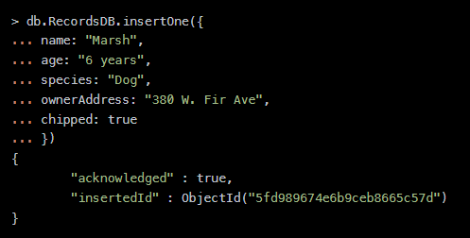
insertOne()
insertOne() allows you to insert one document into the collection.
Insert a single entry into our collection by calling the insertOne() method on RecordsDB.

Slide 24
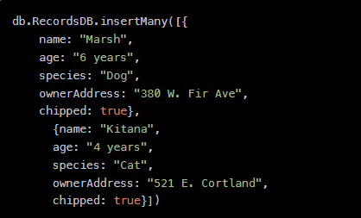
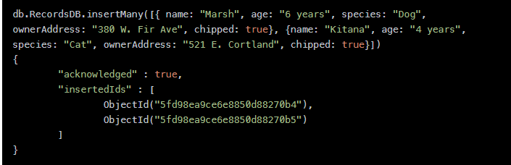
insertMany()
insert multiple items at one time by calling the insertMany() method on the desired collection.

Slide 25
Read operations
The read operations allow you to supply special query filters and criteria that let you specify which documents you want. The MongoDB documentation contains more information on the available query filters. Query modifiers may also be used to change how many results are returned.
MongoDB has two methods of reading documents from a collection:
db.collection.find()
db.collection.findOne()

Slide 26

find()
To get all the documents from a collection, we can simply use the find() method on our chosen collection.
Executing just the find() method with no arguments will return all records currently in the collection.

Slide 27
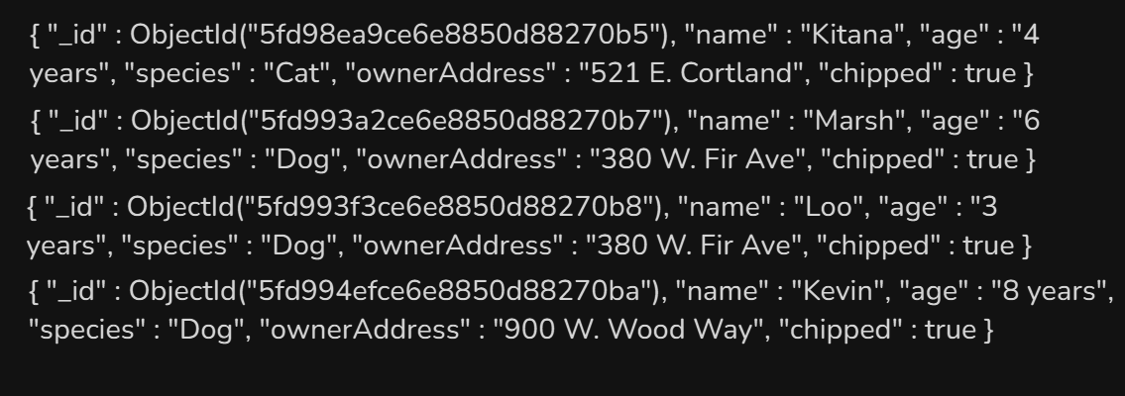
find()
In the result, we can see all the records present in the collection. Note that every record has an assigned “ObjectId” mapped to the “_id” key.

Slide 28


find()
to get more specific with a read operation and find a desired subsection of the records, you can use the previously mentioned filtering criteria to choose what results should be returned.

Slide 29

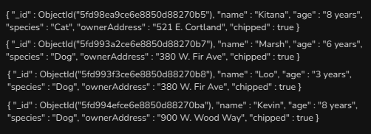
findOne()
this method returns the first document according to the natural order which reflects the order of documents on the disk. If no documents satisfy the search criteria, the function returns null.

Slide 30
Update operations
Like create operations, update operations operate on a single collection, and they are atomic at a single document level. An update operation takes filters and criteria to select the documents you want to update.
updates are permanent and can’t be rolled back. This applies to delete operations as well.
For MongoDB CRUD, there are three different methods of updating documents:
db.collection.updateOne()
db.collection.updateMany()
db.collection.replaceOne()

Slide 31
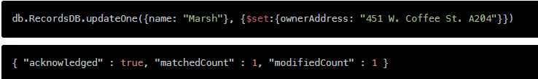
updateOne()
update a currently existing record and change a single document with an update operation.
To update a document, we provide the method with two arguments: an update filter and an update action.

Slide 32
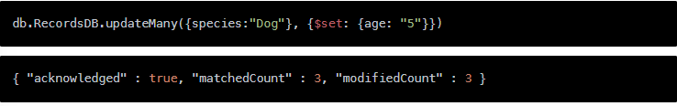
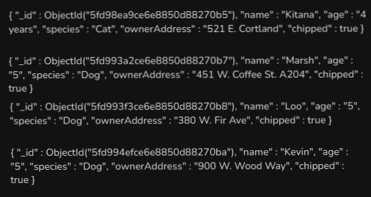
updateMany()
updateMany() allows us to update multiple items by passing in a list of items, just as we did when inserting multiple items. This update operation uses the same syntax for updating a single document.
db.RecordsDB.up
updateMany() allows us to update multiple items by passing in a list of items, just as we did when inserting multiple items. This update operation uses the same syntax for updating a single document.
updateMany() allows us to update multiple items by passing in a list of items, just as we did when inserting multiple items. This update operation uses the same syntax for updating a single document.

Slide 33
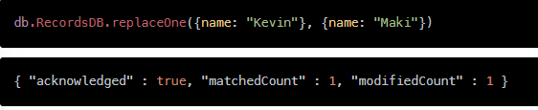

replaceOne()
The replaceOne() method replaces a single document in the specified collection. replaceOne() replaces the entire document, meaning fields in the old document not contained in the new one will be lost.

Slide 34
Delete operations
Delete operations operate on a single collection, like update and create operations. Delete operations are also atomic for a single document. You can provide delete operations with filters and criteria to specify which documents you would like to delete from a collection. The filter options rely on the same syntax that read operations utilize.
MongoDB has two different methods of deleting records from a collection:
db.collection.deleteOne()
db.collection.deleteMany()

Slide 35
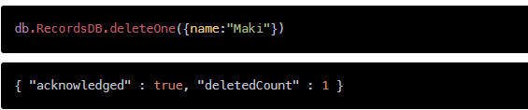

deleteOne()
deleteOne() removes a document from a specified collection on the MongoDB server. A filter criteria is used to specify the item to delete. It deletes the first record that matches the provided filter.

Slide 36
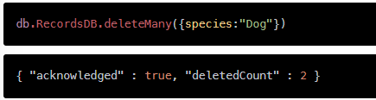
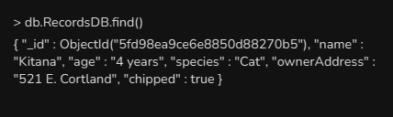
deleteMany()
deleteMany() is a method used to delete multiple documents from a desired collection with a single delete operation. A list is passed into the method and the individual items are defined with filter criteria as in deleteOne().

Slide 37


